Slide 1
It Worked in my System!
Hosteller App
Team Members:
Tushar Amrit
Aditya Bhandari
Shubham Sharma
___

Slide 2
Description of the Project
Problem Statement
Approach to the Solution
To provide a safe and efficient way to manage the arrival and stay of thousands of college students back to their hostels and to contain
the disease as much as
possible.
We aim to develop a complete app that not only uses ML to allot the most suitable time slot of arrival but also reduces the risk of any corona outburst in the hostels.
Relevance to the Theme
Techstack Involved
Our product The Hosteller App helps to improve the ‘new normal’ that we are living in the post-Covid period.
Android Development and Machine Learning.

Slide 3
Details of Technology Stack
Tech1
Android App
Firebase BaaS
Tech2
Tech3
ML Model hosted on Firebase AutoML

Slide 4
Novelty of the Solution
Our solution is one of a kind and tailor made for hostels that are part of colleges where students comes for various regions.It provide a safe and efficient way to manage the arrival and stay of thousands of college students back to their hostels.

Slide 5
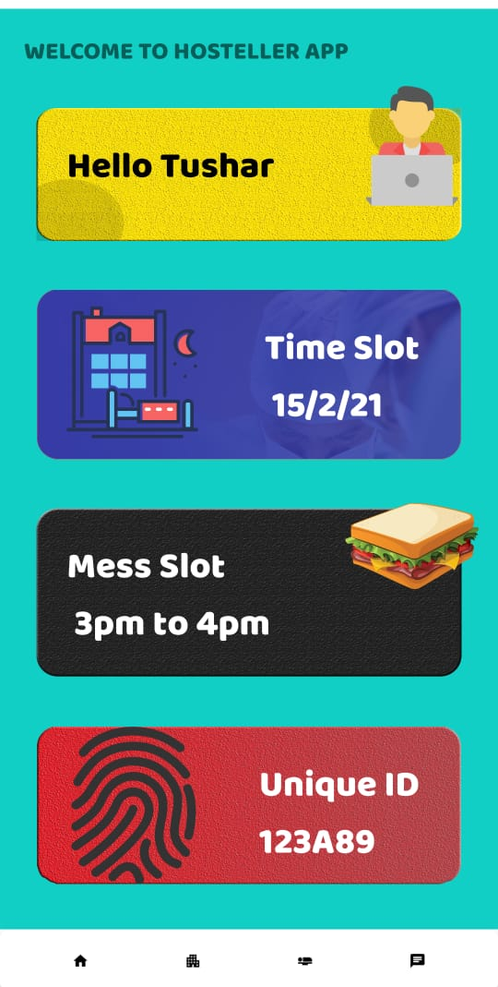
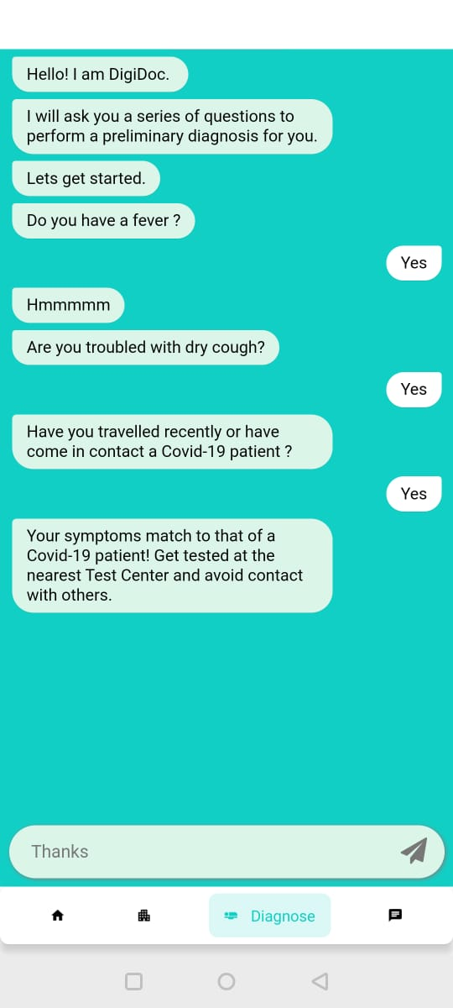
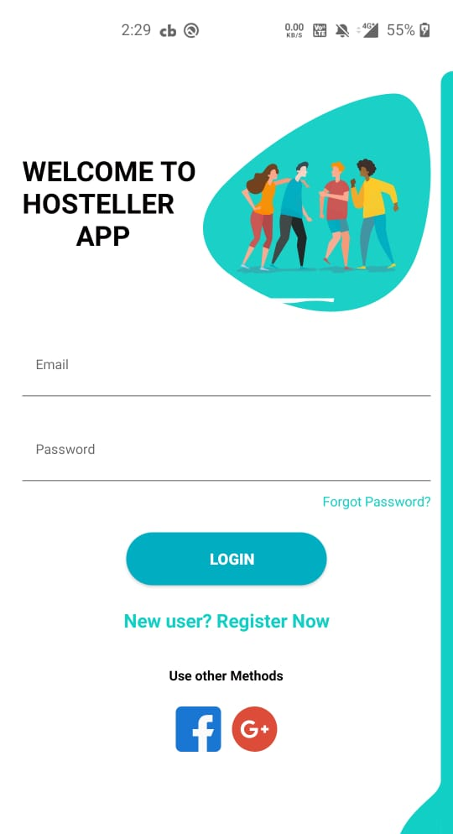
Working Prototype
Github Repo Link: https://github.com/tushar-amrit-6/HostellerApp
Screen Shots:

Slide 6
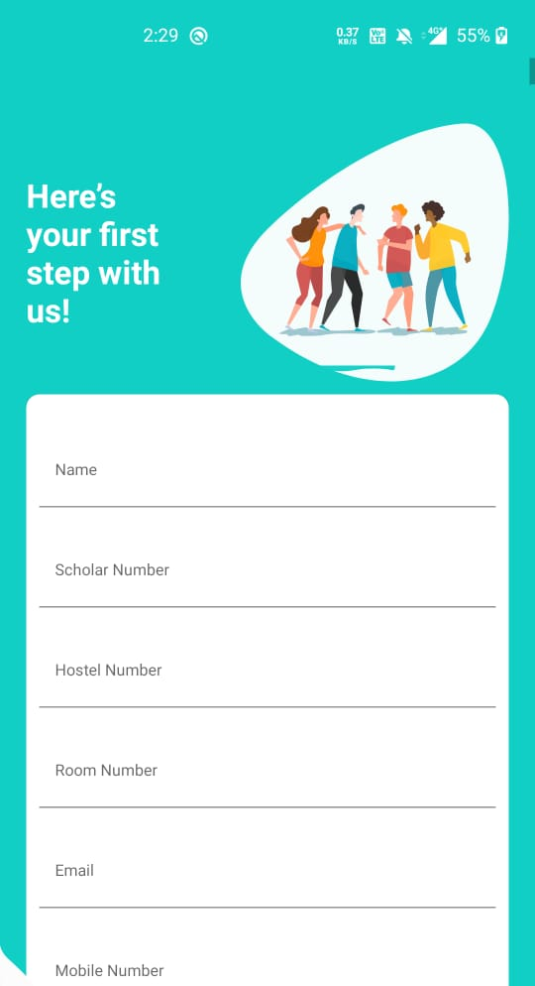
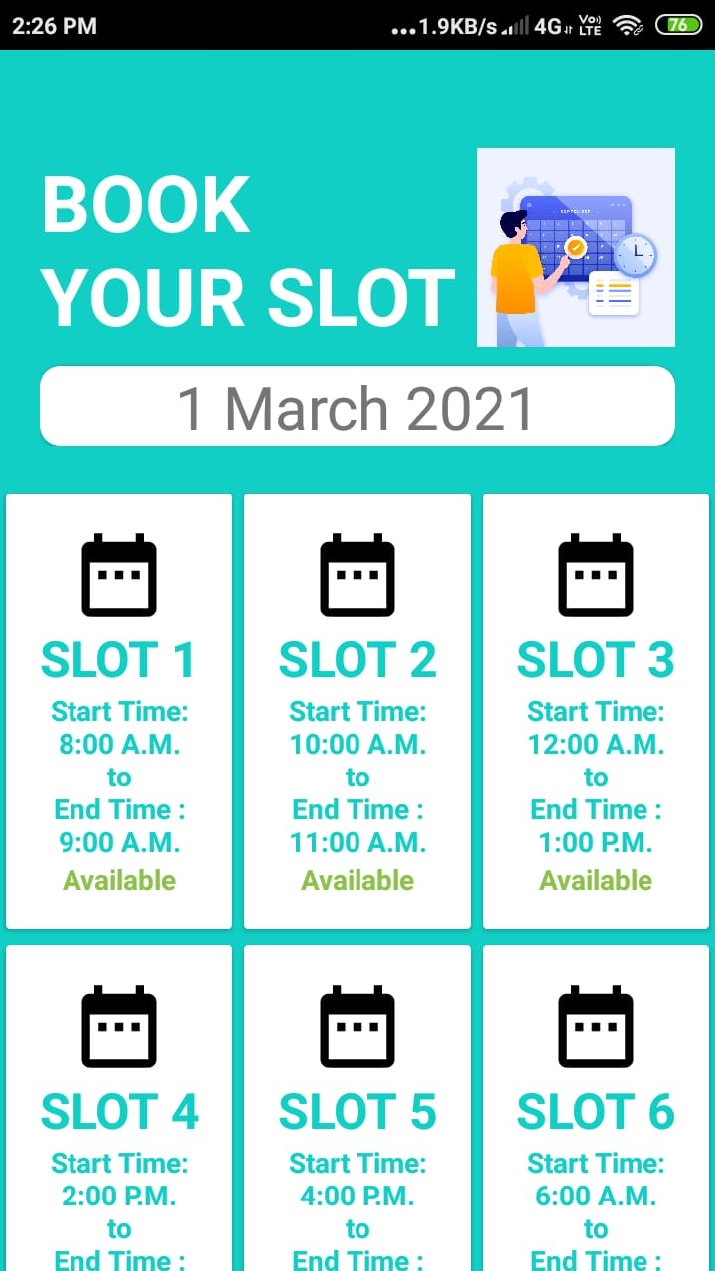
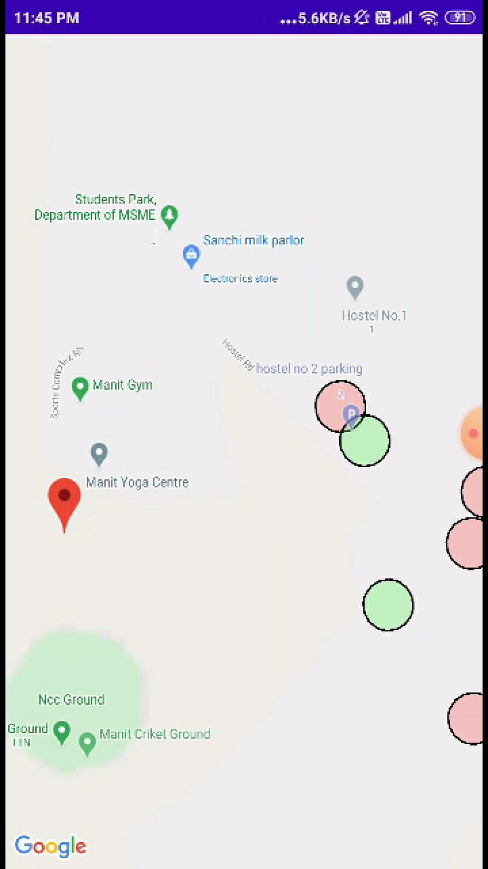
Working Prototype

Slide 7
Learning Curve
What have you learnt by doing this project?
04
01
Ideation
Observed a problem of immediate importance and jotting down ideas to solve it.
03
02
Project Design & Teamwork
02
Dividing the project into various modules and working so that each member can work on what he is best at
01
03
Intricacies & Time Management
Trying to discover how the app will work best and encountering various errors and working it out by understanding the intricacies of the technology, all during the interval of the hack.
04 Marketing
Pitching and selling our idea, to prove why it is the best at its job.

Slide 8
About Team
01
02
Tushar Amrit
Aditya Bhandari
Frontend Developer
Backend Developer
03
Shubham Sharma
Backend Developer

